Slide 1


Manuel Ballesteros Carballo
Ingeniero de Diseño y Desarrollo
Congreso SWYP´17
Marzo 2017

Slide 2

RF is Black Magic!!!
Notes:
Maxwell's Equations
Smith Chart
impedance matching and transmission line analysis
Electromagnetic waves
Video of Mikes Electric Stuff from UK
https://youtu.be/eyA2lWQrxwg?t=1011

Slide 3
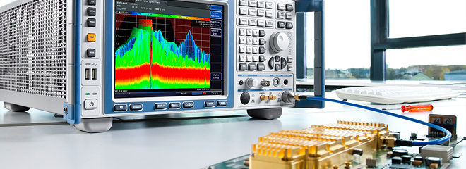
Spectrum Analyzer

Slide 4
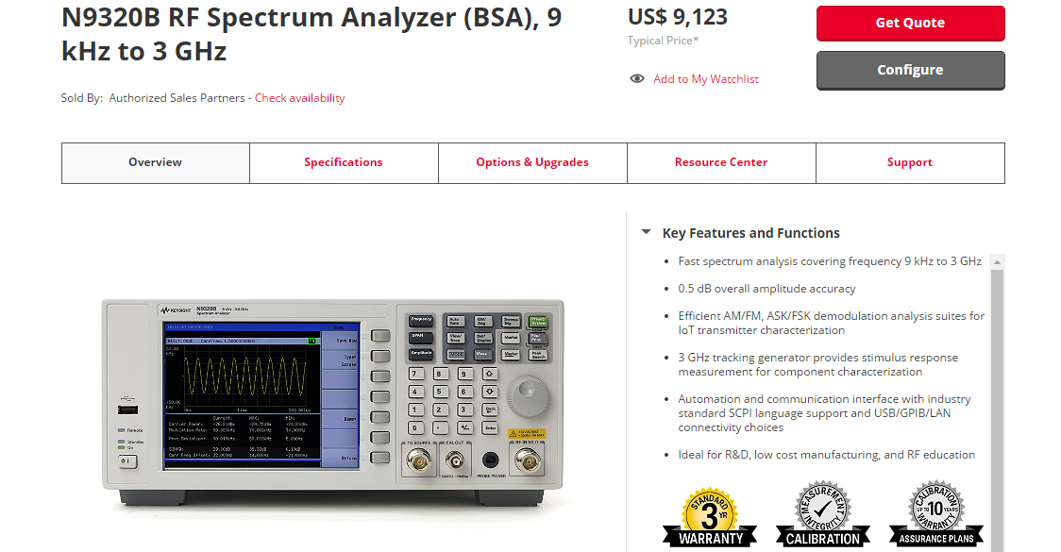
Take my money and shut up!!!

Slide 5
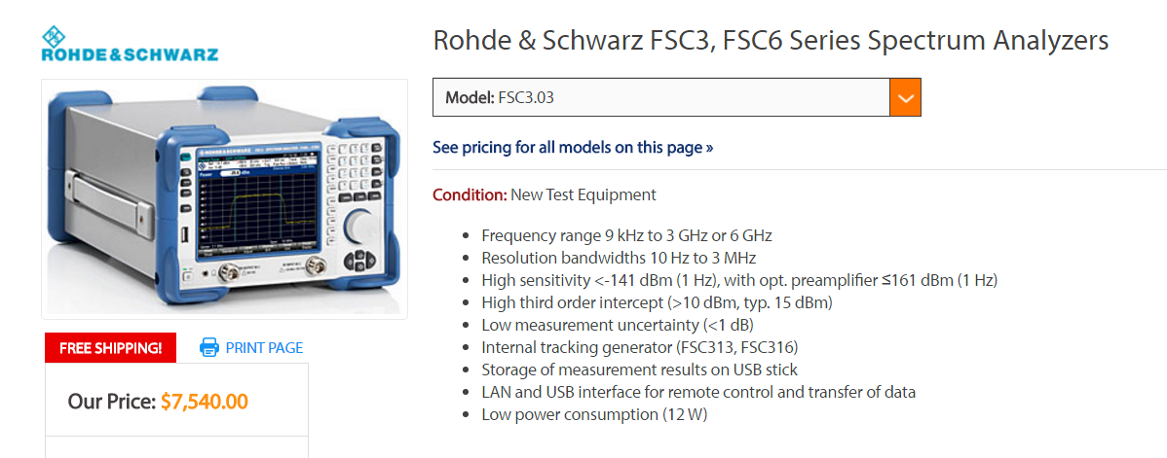
Ohhh… Wait!!

Slide 6
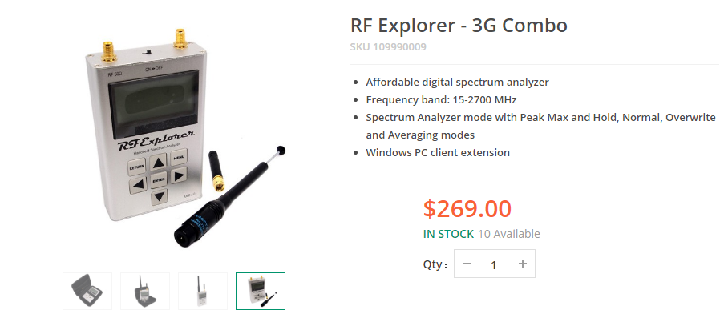
RF Explorer Spectrum Analyzer

Slide 7
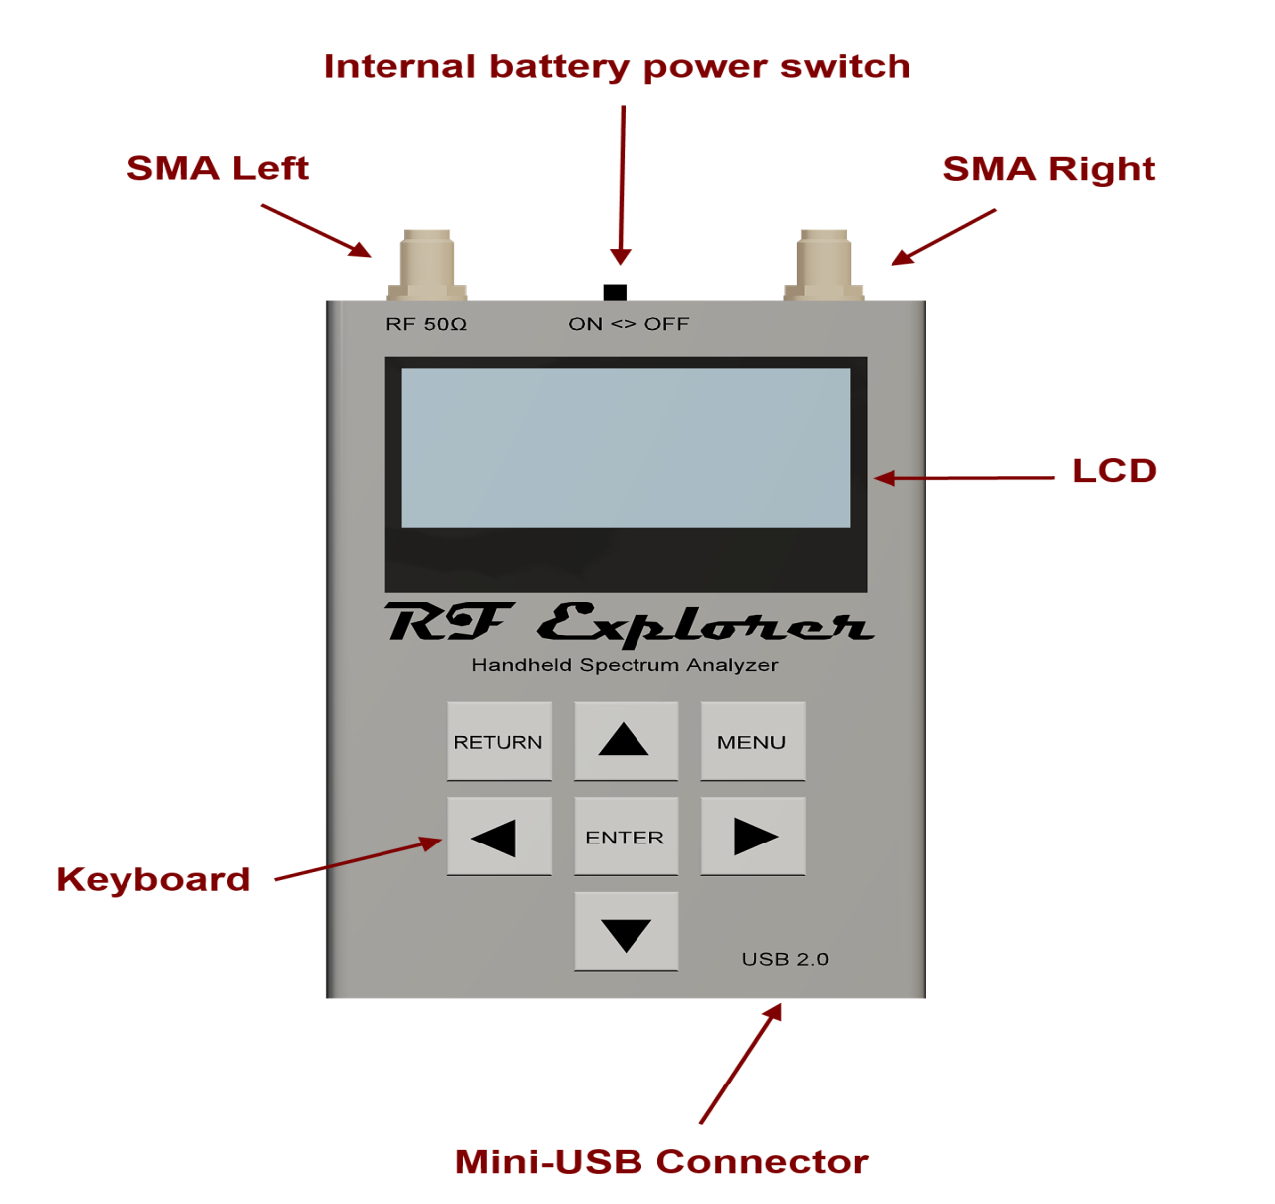

Slide 8
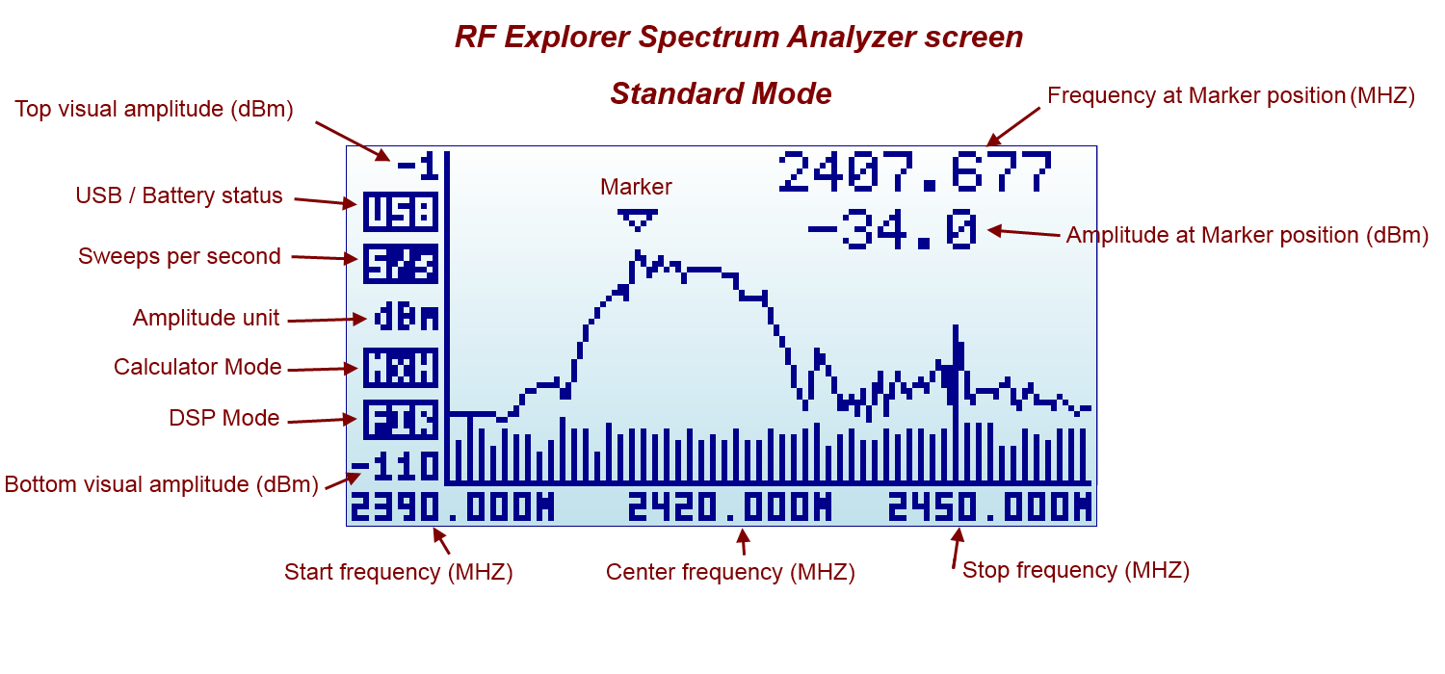
Spectrum Analyzer Screen

Slide 9
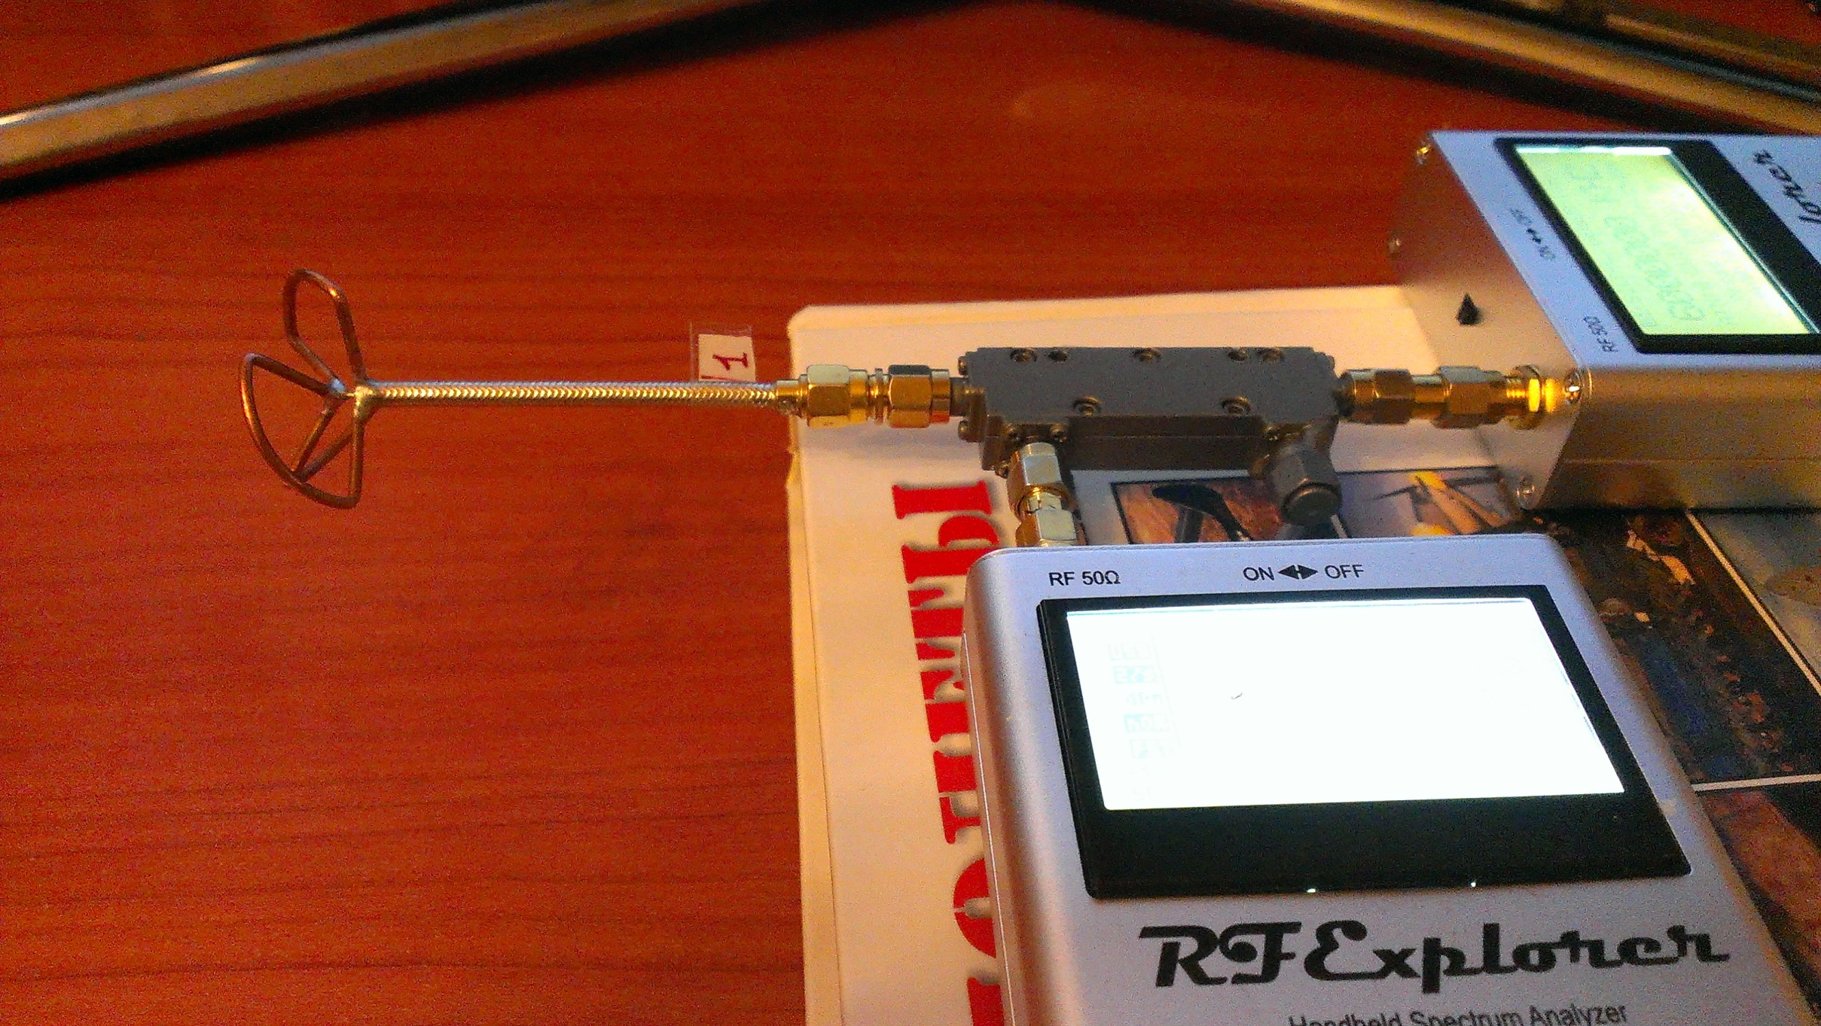
Fans of Radio Control
Notes:
Fans of Radio Control
Audio Engineers
Amateur Radio
Hackers and Makers
Education

Slide 10
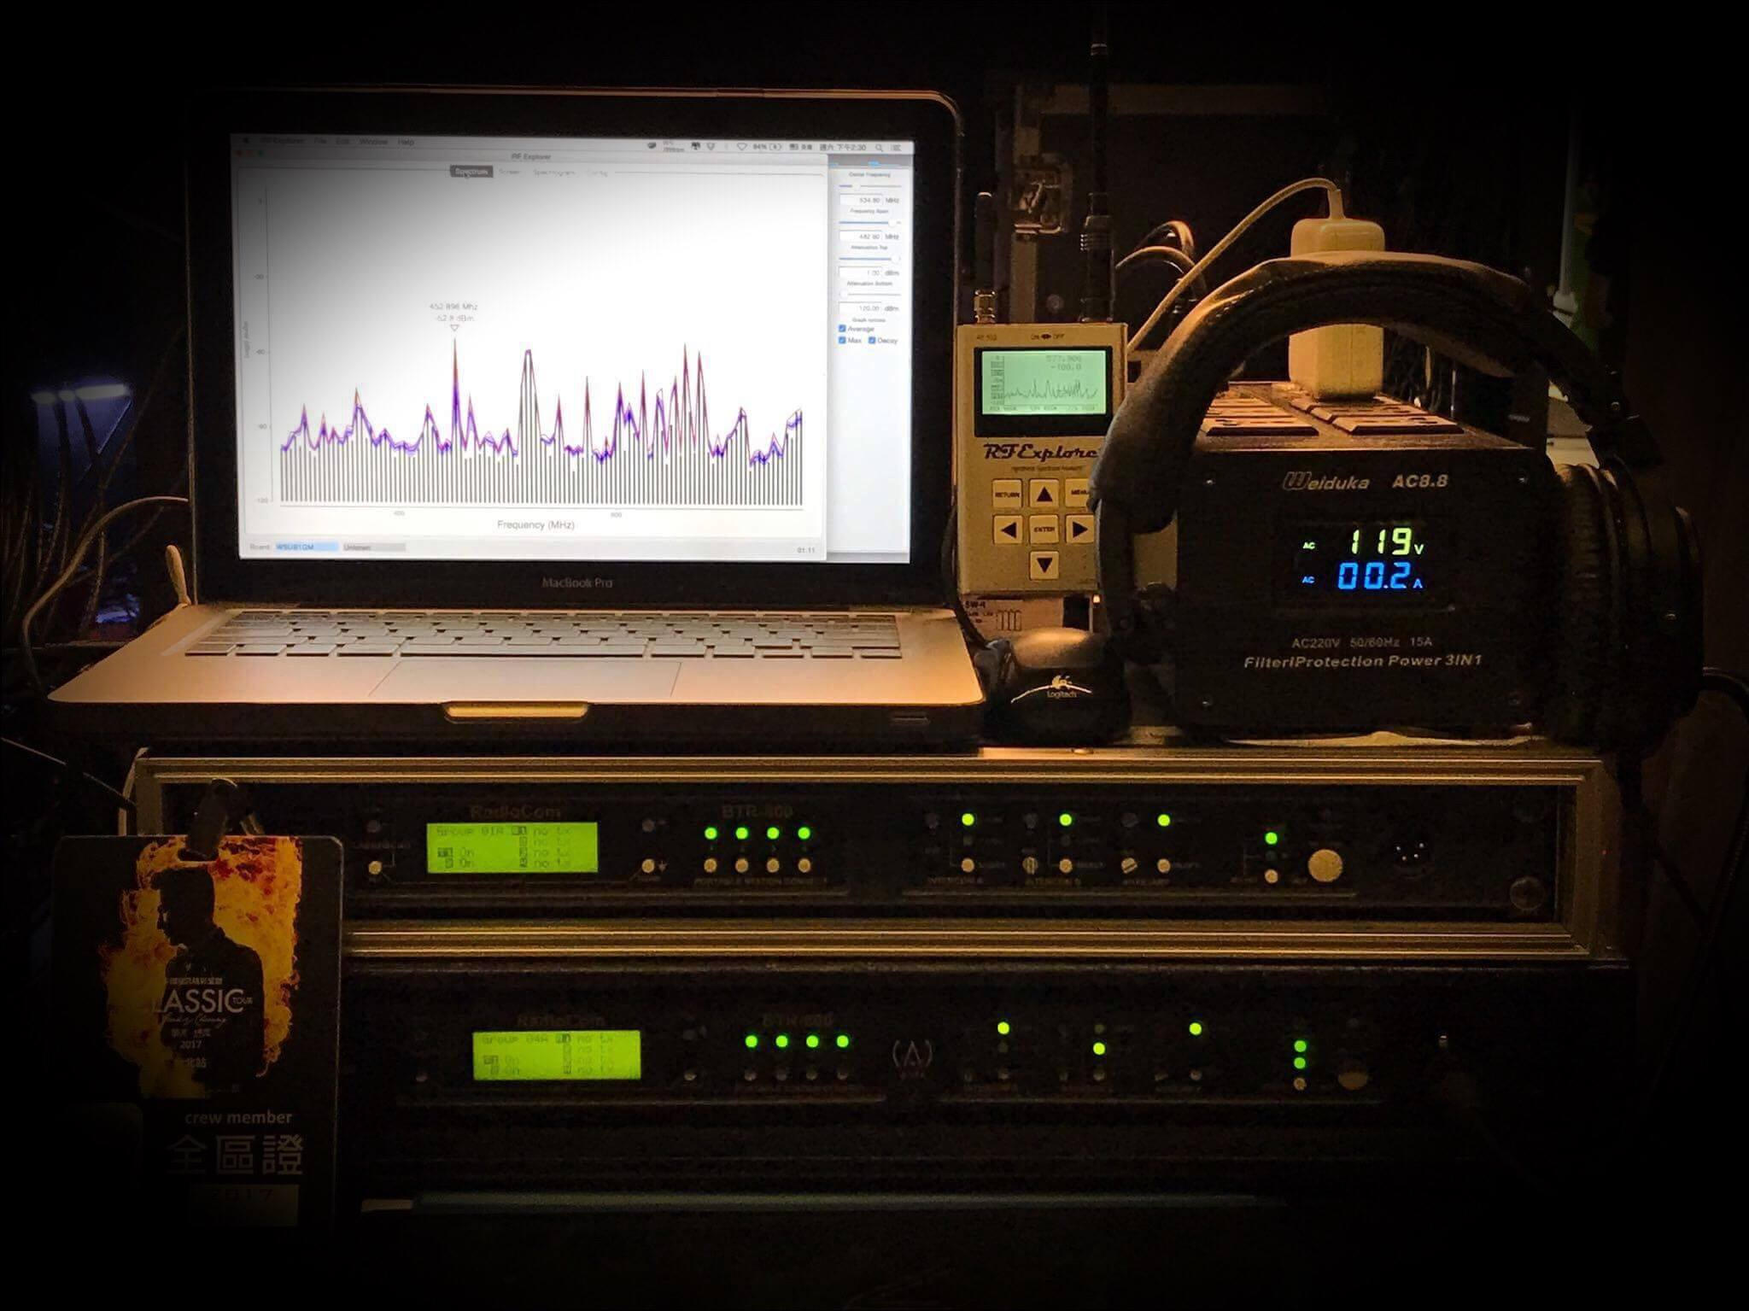
Audio Engineers

Slide 11
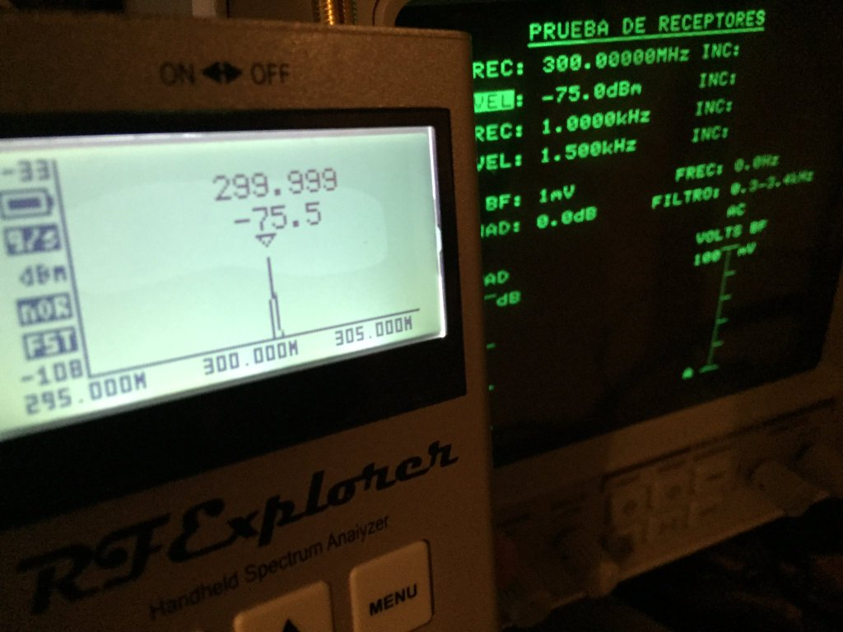
Amateur Radio

Slide 12
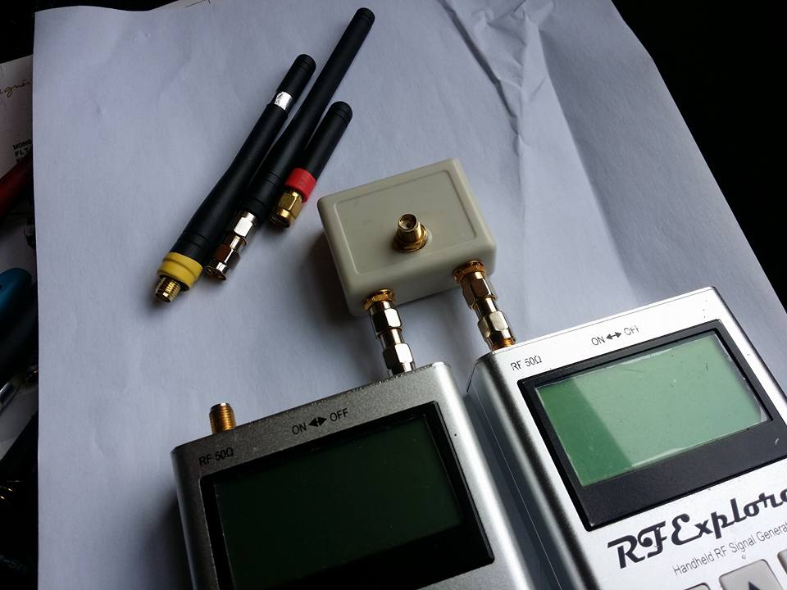
Hackers and Makers

Slide 13
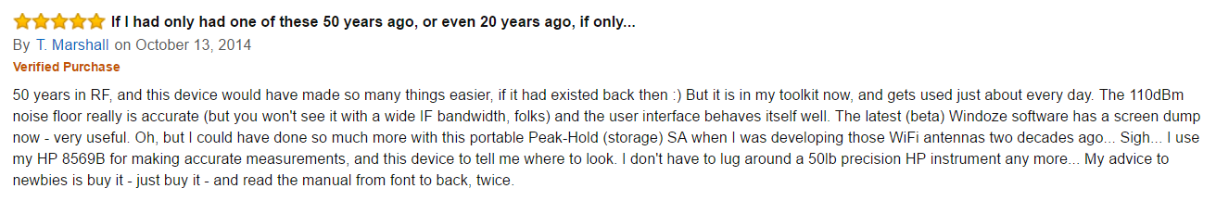
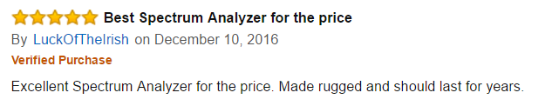
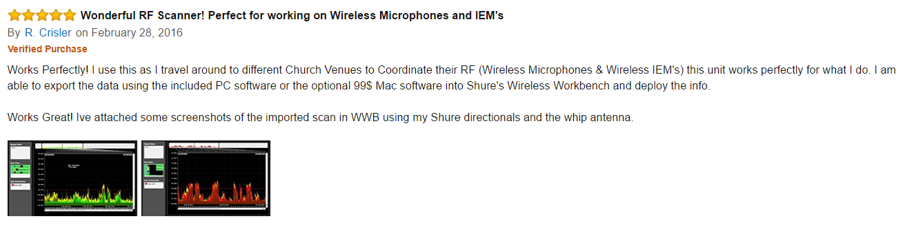
Opinions

Slide 14
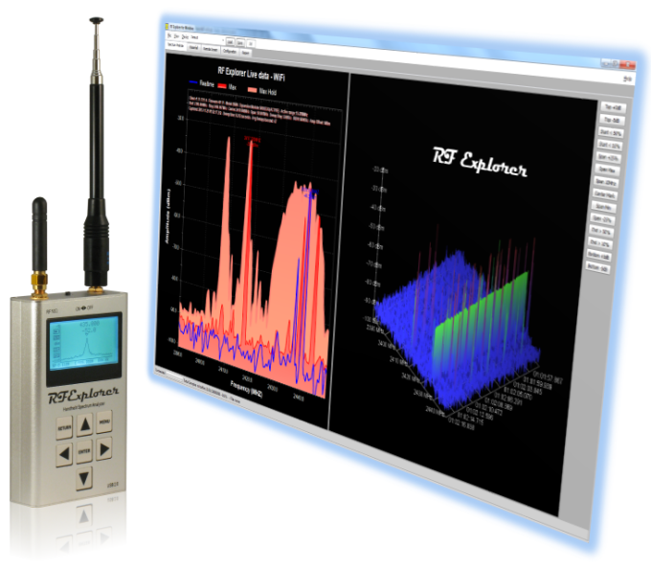
Software

Slide 15
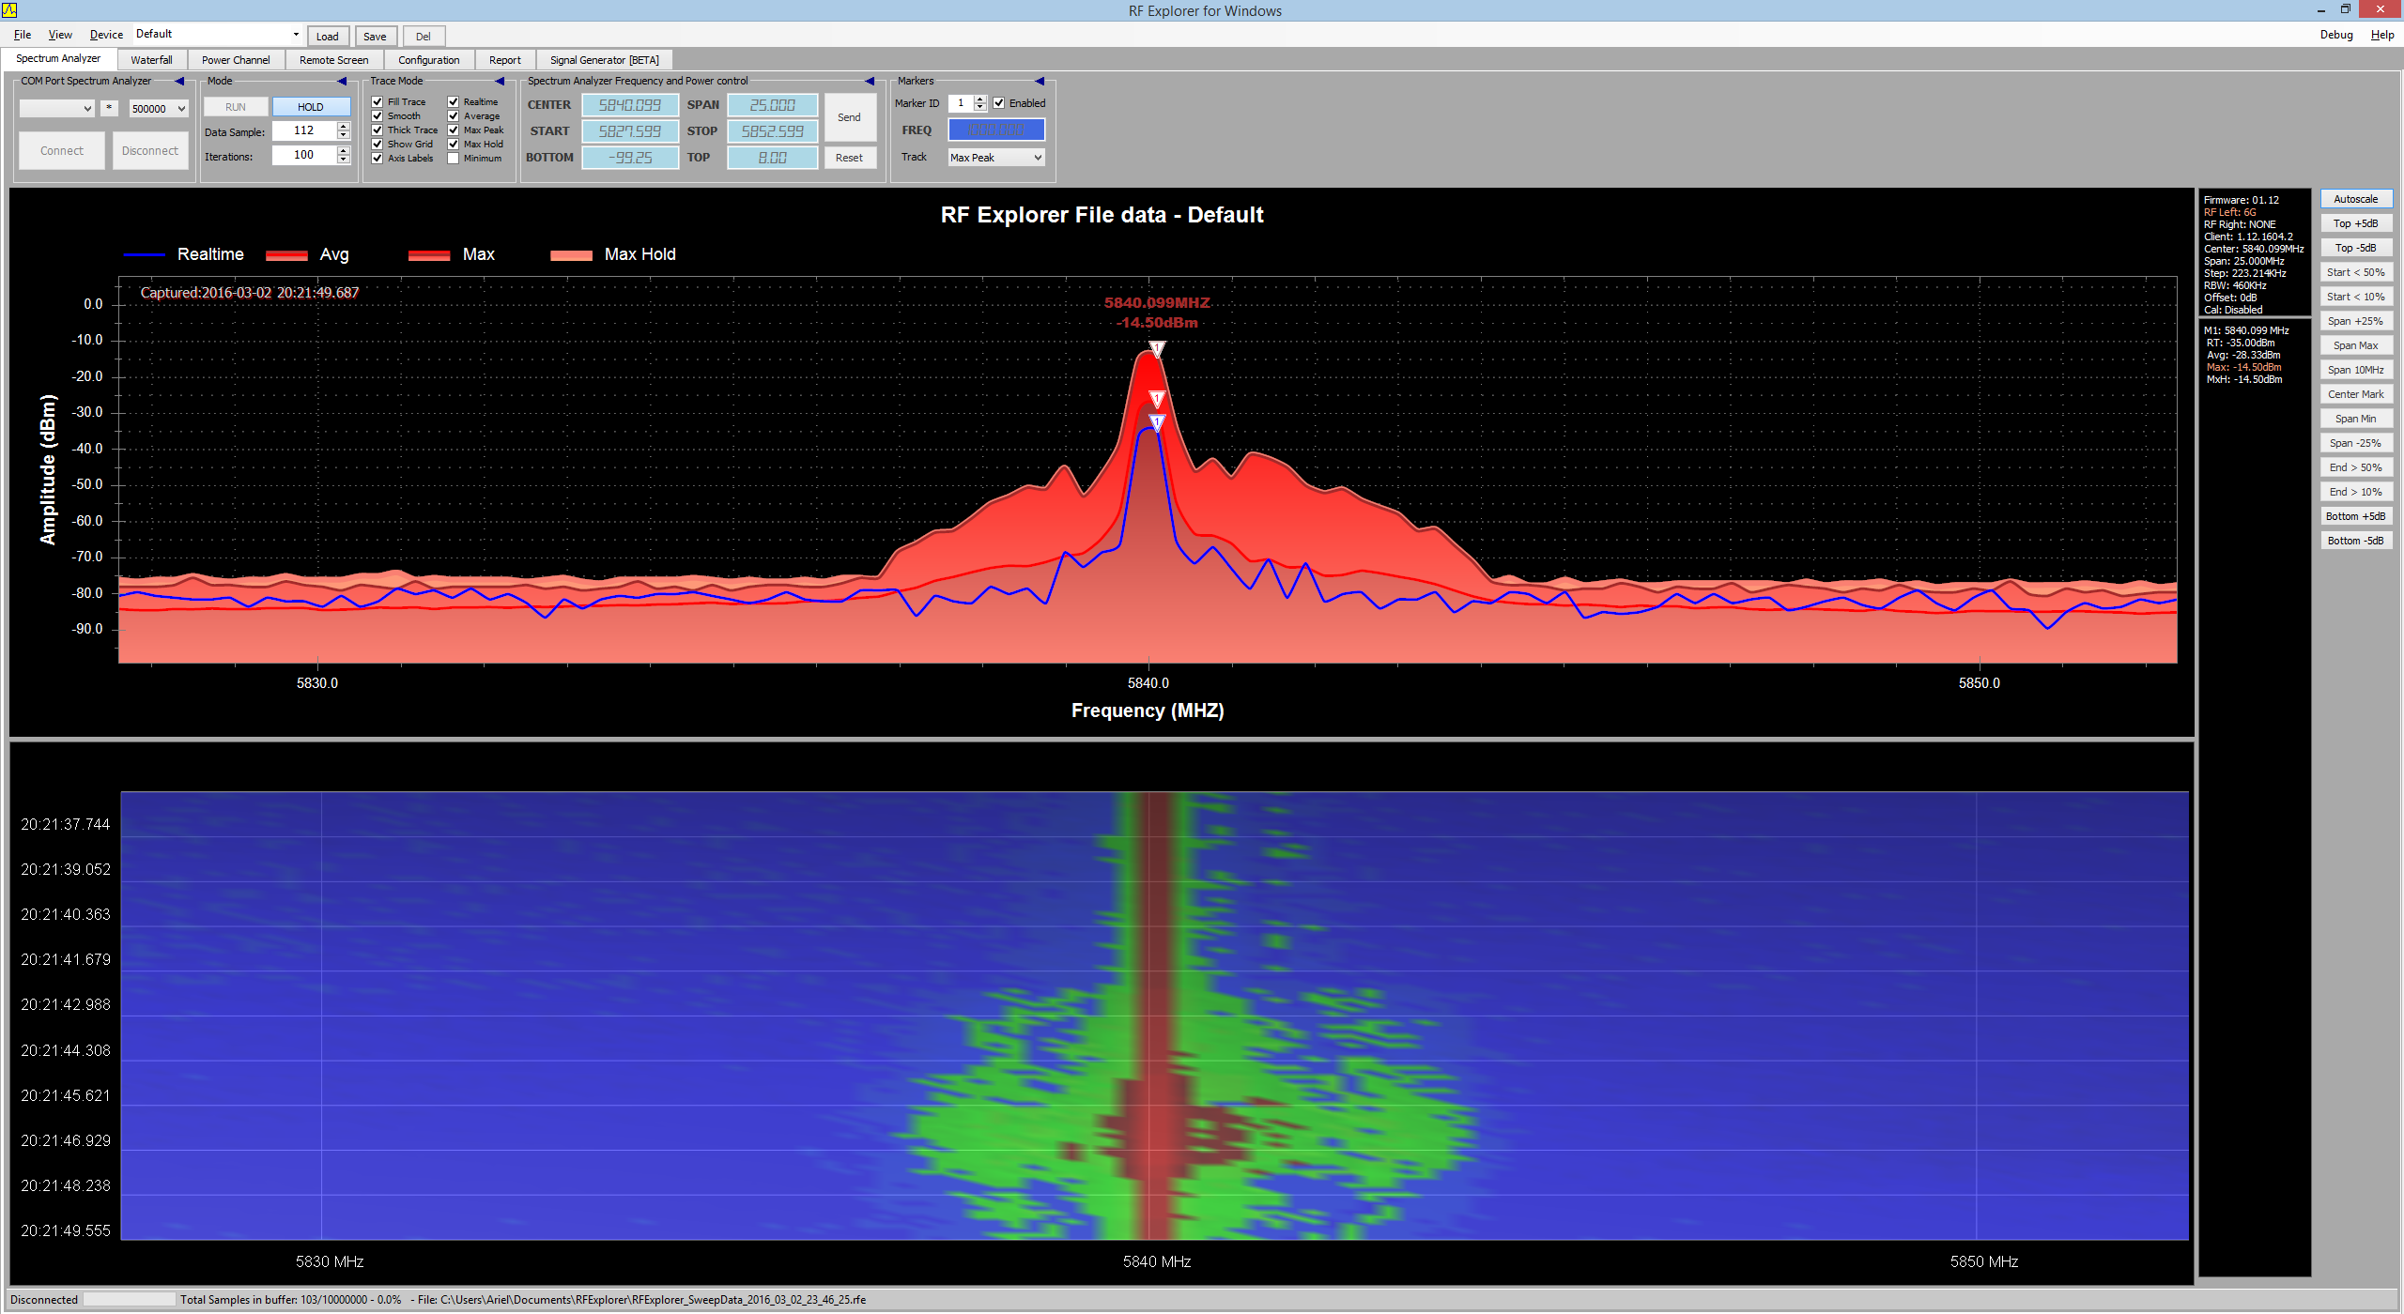

Slide 16
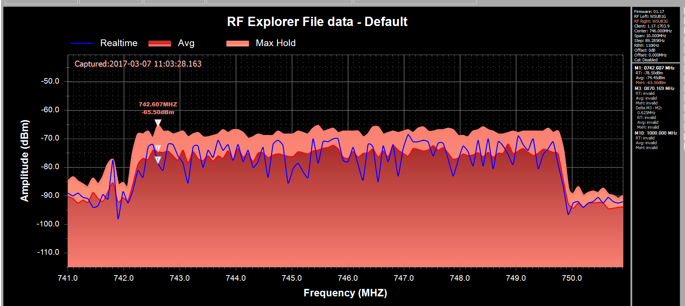

Slide 17
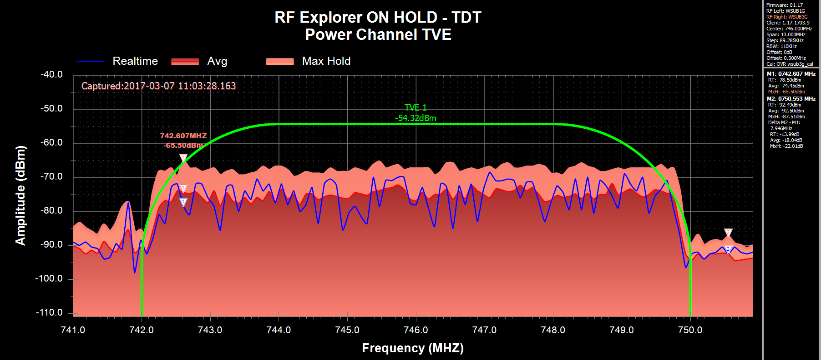

Slide 18
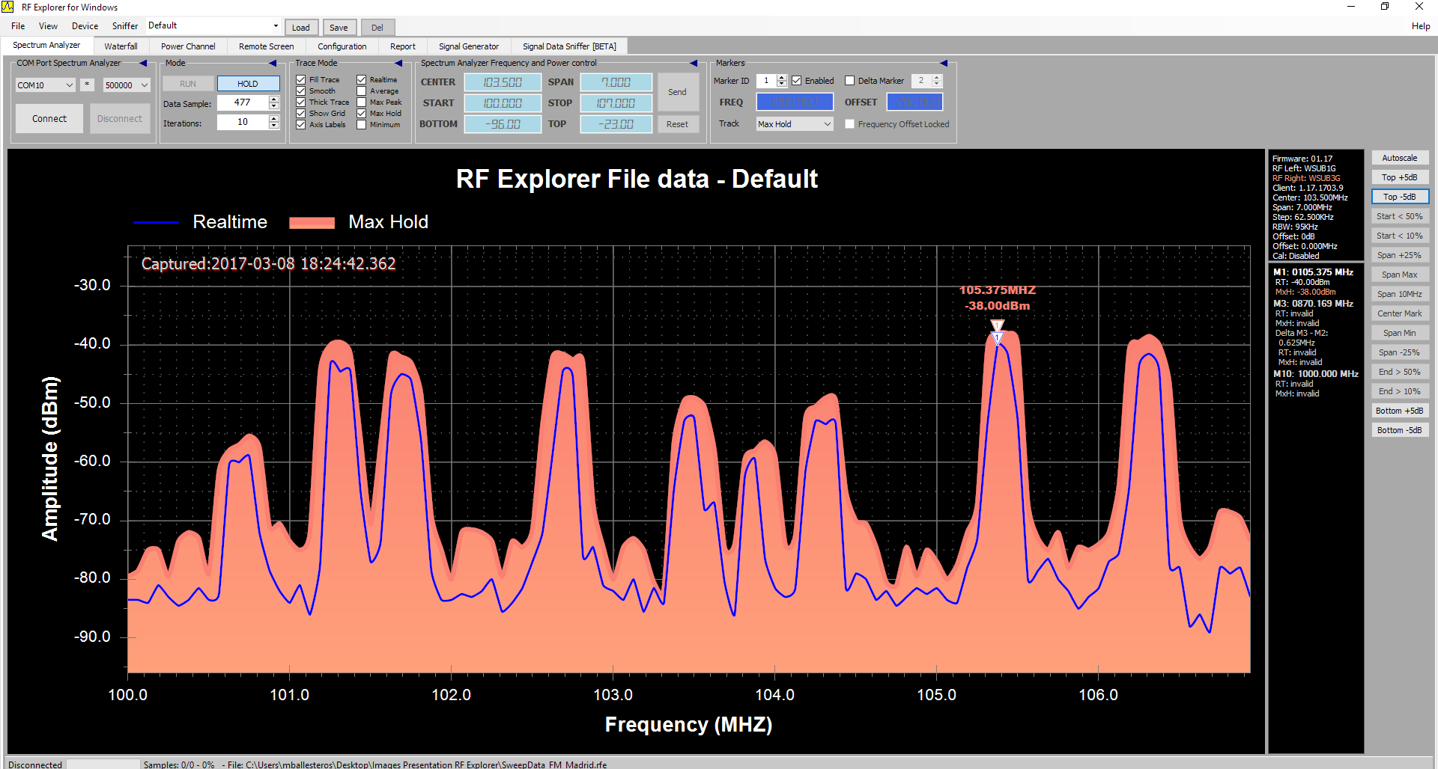

Slide 19
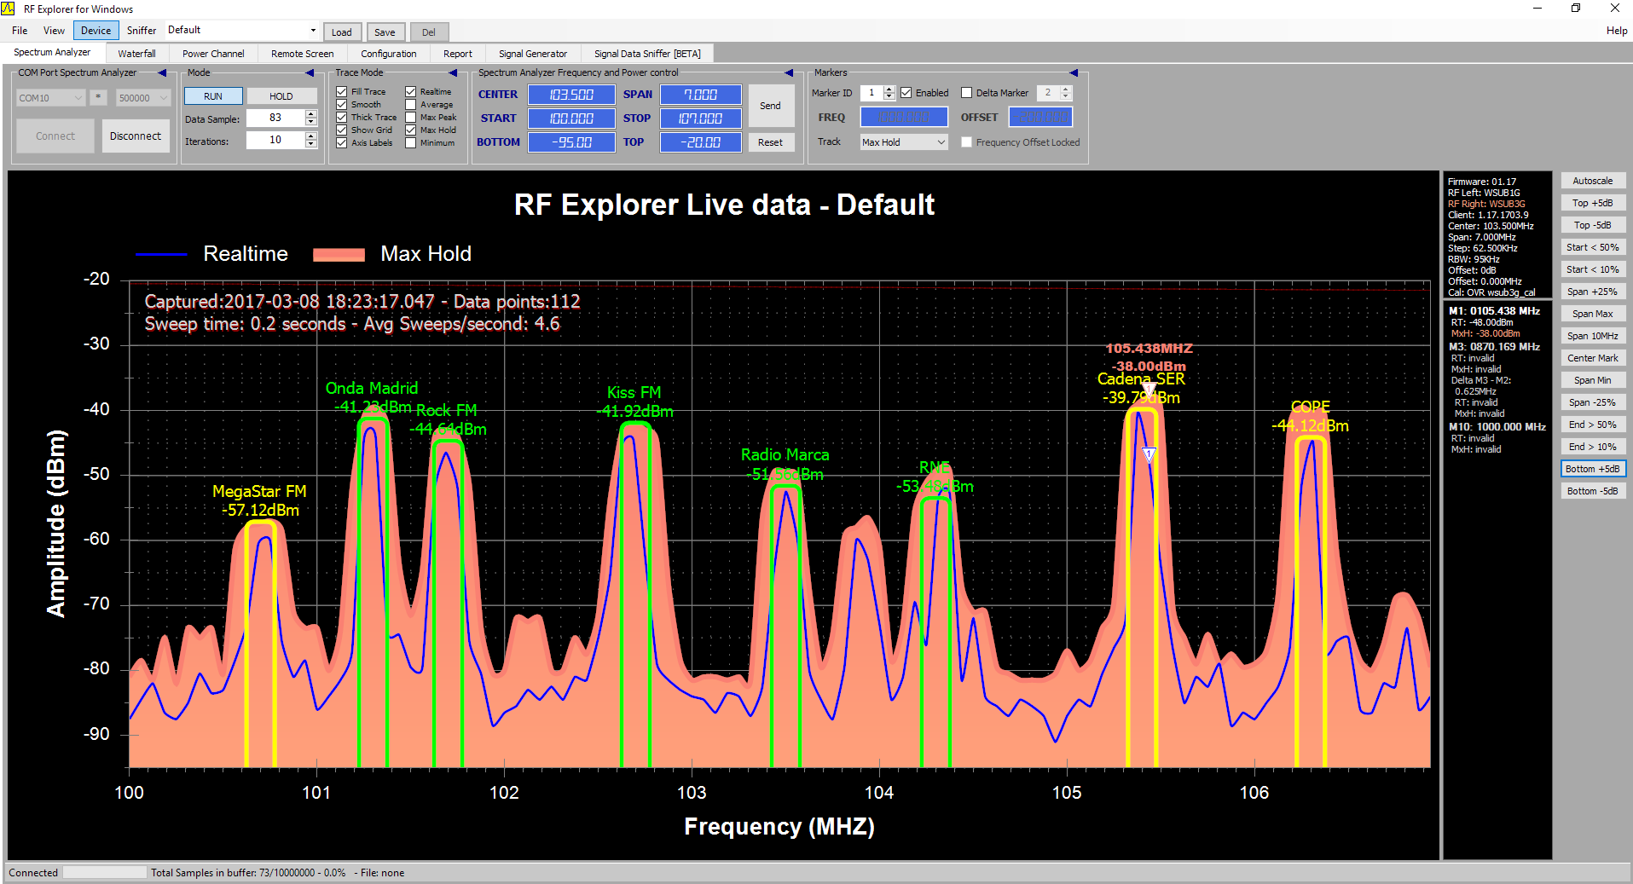

Slide 20
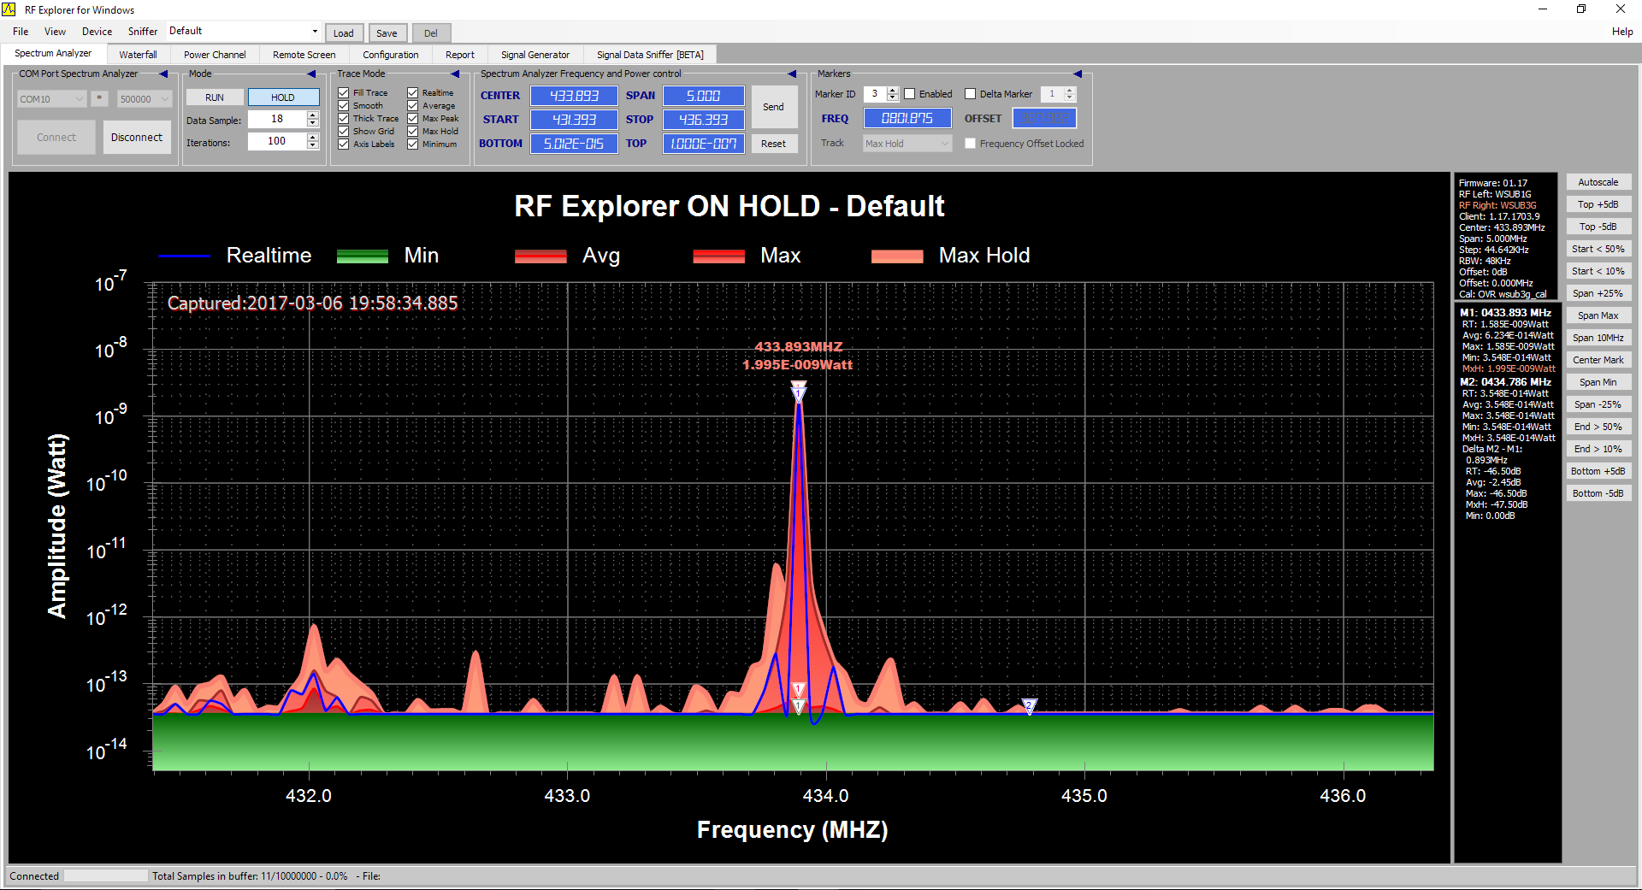
Signal Discovered

Slide 21
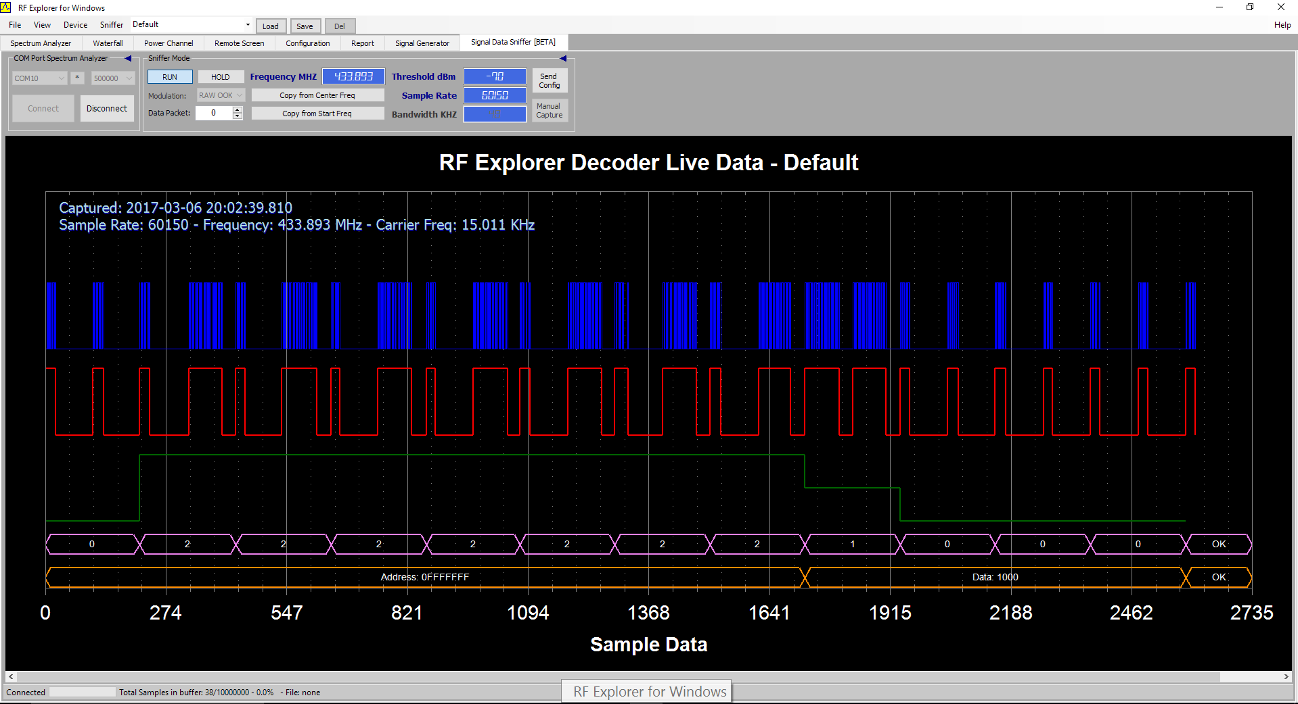
Demo: Sniffer

Slide 22

RF Explorer
Signal Generator

Slide 23
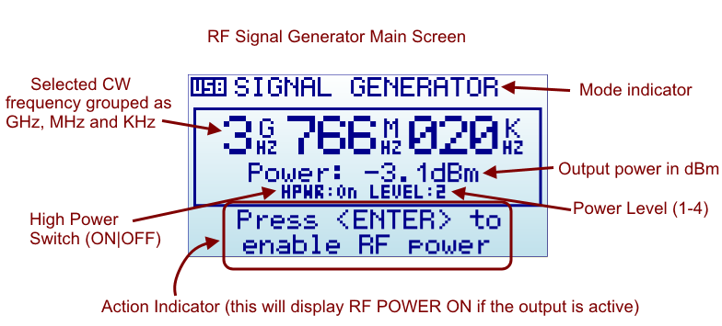
Signal Generator

Slide 24
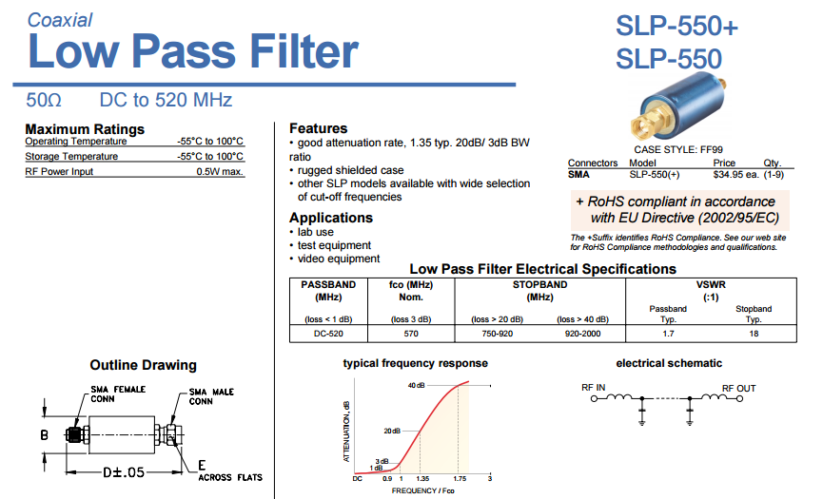

Slide 25
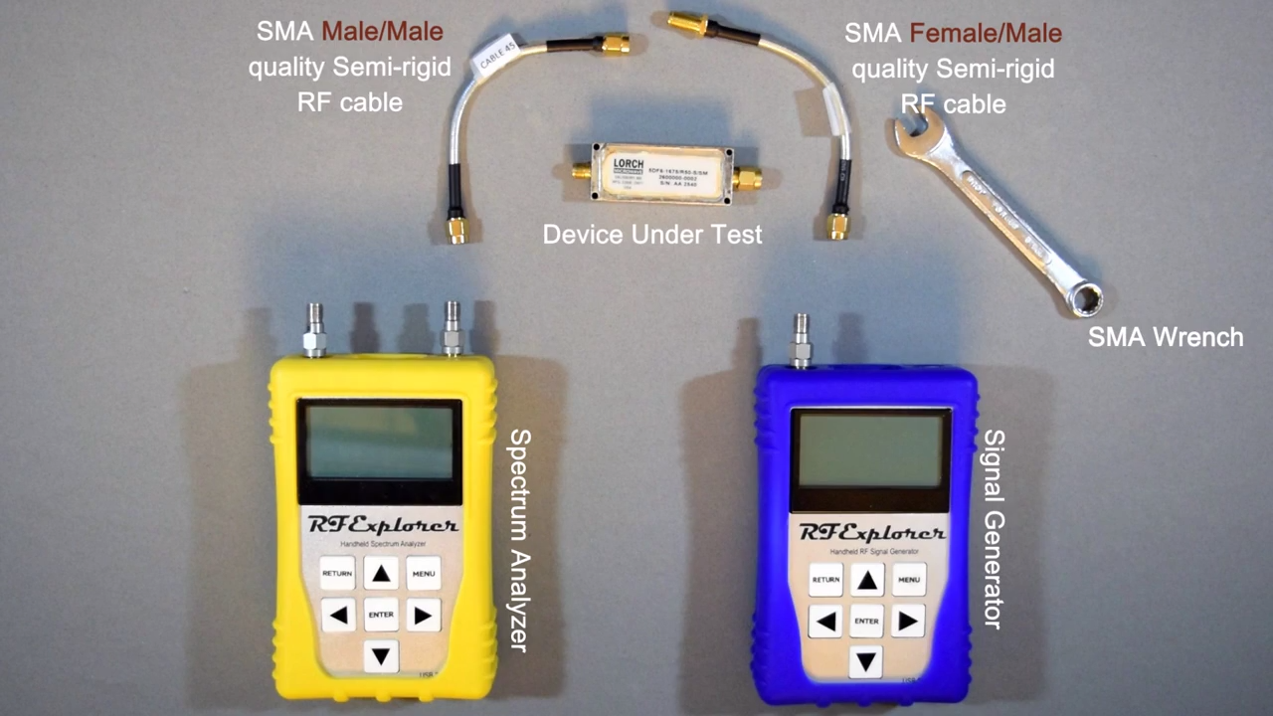
SNA (Scalar Network Analyzer)

Slide 26
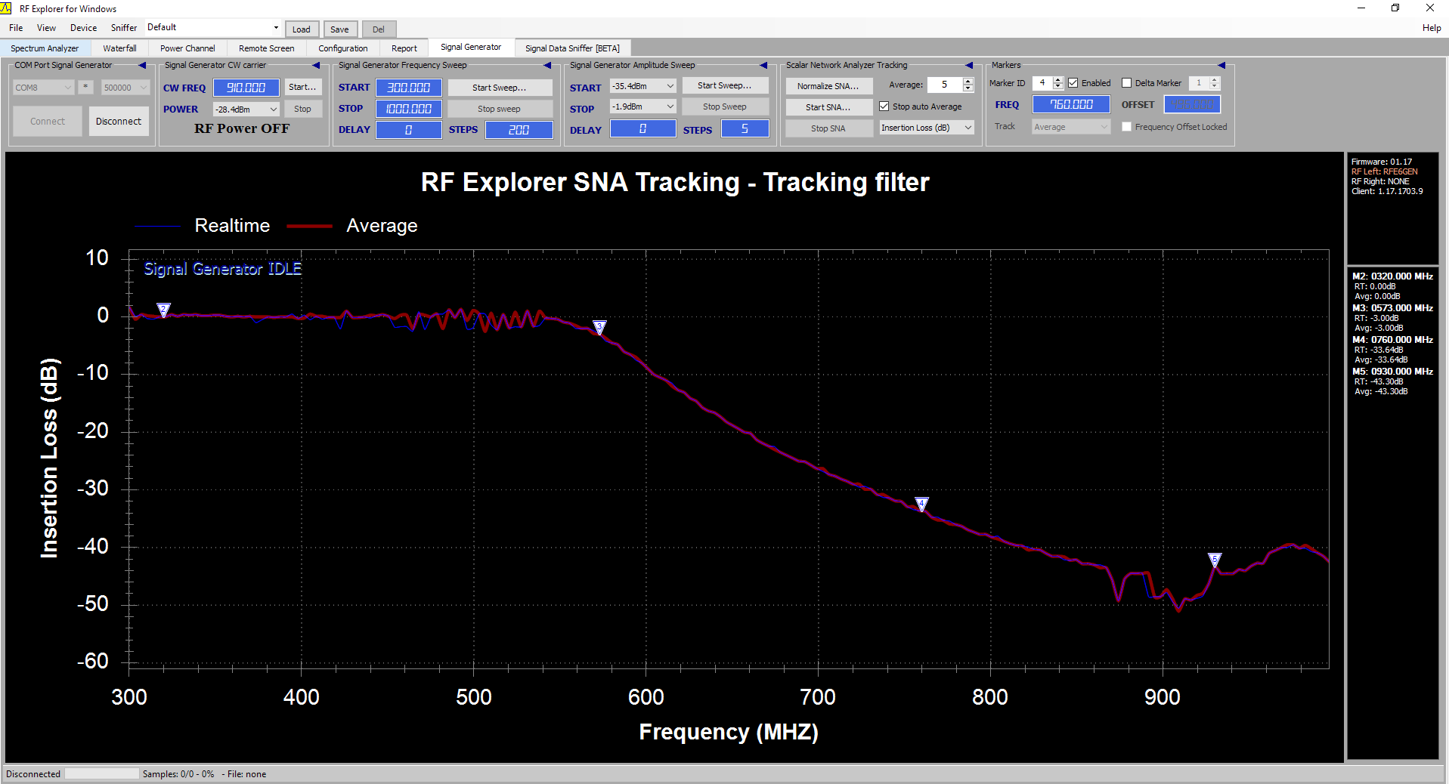
SNA (Scalar Network Analyzer)

Slide 27
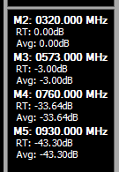
Mithbuster
Confirmed!

Slide 28
Showroom

Slide 29
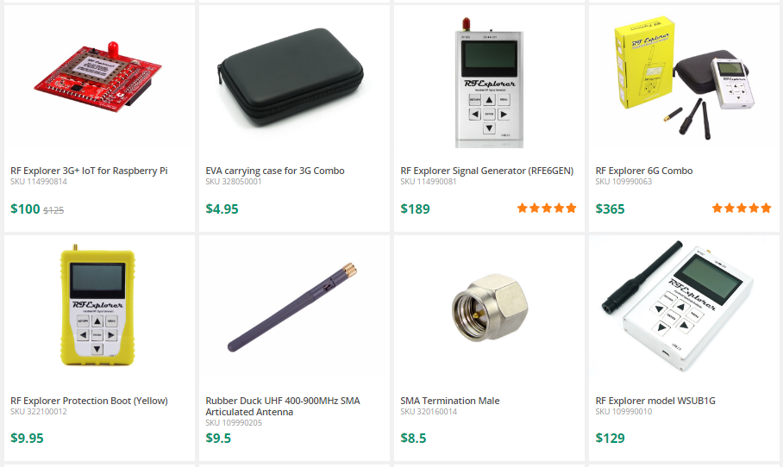

Slide 30
Conclusions
RF is not Black Magic
RF Explorer makes instrumentation economical and user- friendly
Discover Signals on Environment – Spectrum Analyzer
Inyect Signal in a circuit/ Measures Network Parameter – Signal Generator
Manuel is the best

Slide 31


Slide 32


Slide 33
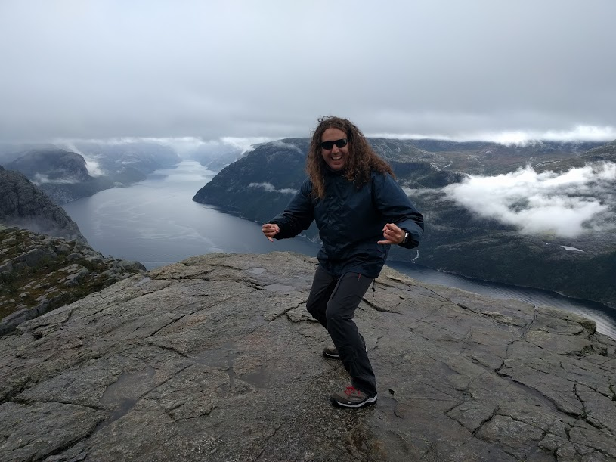
GRACIAS!!!
Podéis encontrarme en:
Contacto -> mballesteros@rf-explorer.com
Más Info -> www.rf-explorer.com

